Slide 1
Soft Computing
Radial Basis Function Network

Slide 2
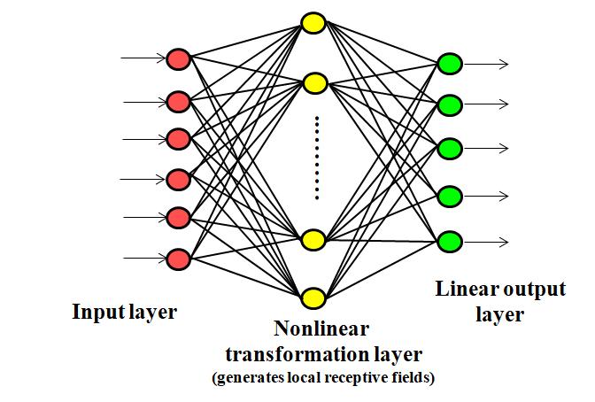
RBF
The RBF networks, just like MLP networks, can therefore be used classification and/or function approximation problems.
The RBFs, which have a similar architecture to that of MLPs.

Slide 3
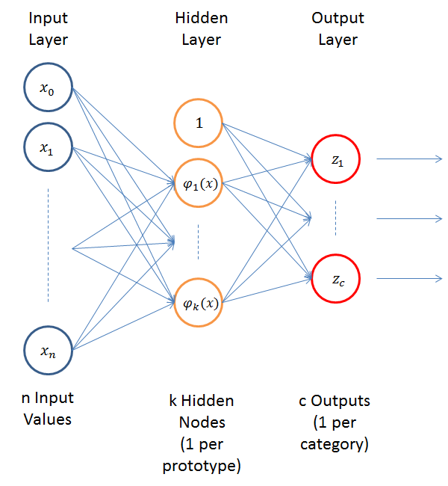
RBF

Slide 4
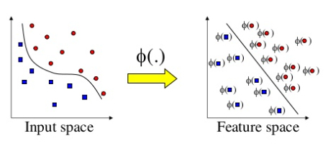
Cover’s Theorem
A complex pattern classification problem that is nonlinearly separable in a low dimensional space, is more likely to be linearly separable in a high dimensional space.
Idea of Kernel Methods to transform input x_{i} to high dimensional ϕ_{i}

Slide 5
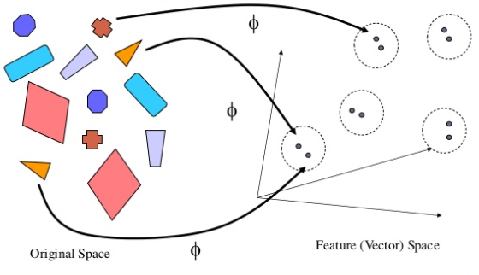
Kernel is a mapping method

Slide 6
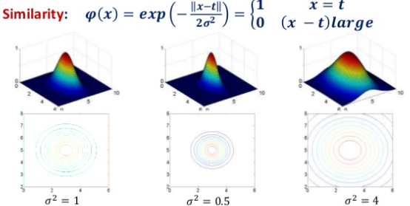
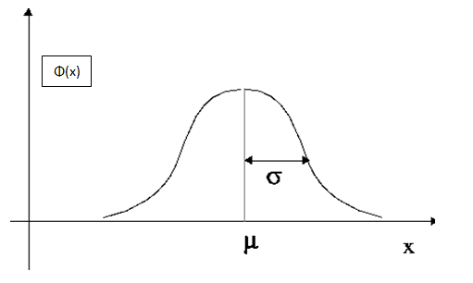

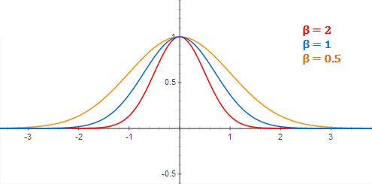
Kernel is a mapping method

Slide 7
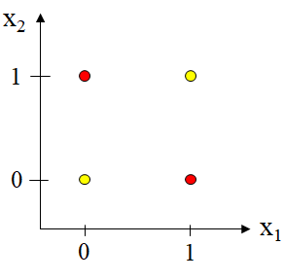
Example
Consider the XOR Problem
We will define a Gaussian hidden function
x1 | x2 | t
0 | 1 | 1
1 | 1 | 1
0 | 0 | 0
1 | 1 | 0
1
0
X = [x₁ x₂]

Slide 8
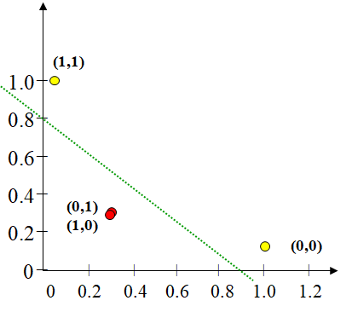
Example
Using the pair of Gaussian hidden functions, input patterns are mapped into ϕ₁ and ϕ₂ planes, and now it is linearly separable.
Input x | ϕ₁(x) | ϕ₂(x)
(1,1) | 1 | 0.1353
(0,1) | 0.3678 | 0.3678
(1,0) | 0.3678 | 0.3678
(0,0) | 0.1353 | 1

Slide 9
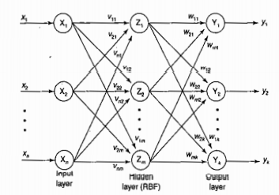
RBF Architecture

Slide 10
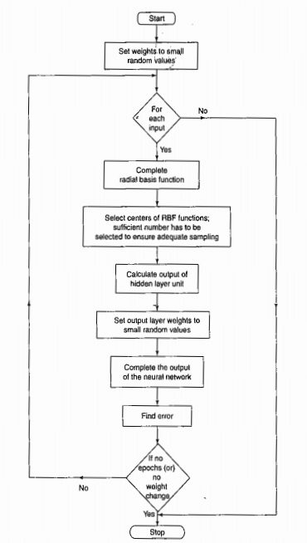
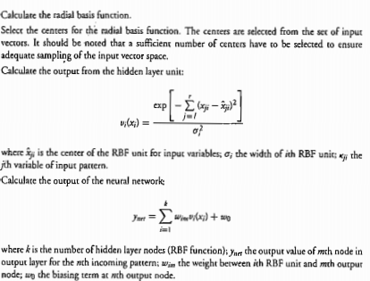
RBF

Slide 11
Comparison of MLP and RBF networks
An RBF network has a single hidden layer. An MLP has one or more hidden layers;
Typically the nodes of an MLP in a hidden or output layer share the same neuronal model. On the other hand the nodes of an RBF in a hidden layer play a different role than those in the output layer;
The hidden layer of an RBF is non-linear. The output layer is linear. Typically in an MLP both layers are nonlinear.

Slide 12
Comparison of MLP and RBF networks
An RBF network computes as argument of its activation function the Euclidean norm of the input vector and the center of the unit.
In MLP networks the activation function computes the inner product of the input vector and the weight vector of the node.
MLPs are global approximators; RBFs are local approximators due to the localised decaying Gaussian (or other) function.

Slide 13
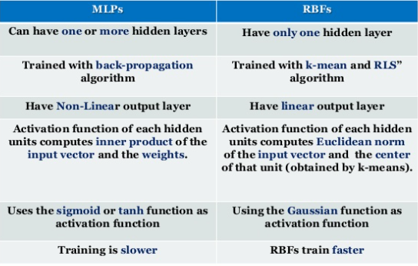
MLP vs RBF

Slide 14
There are various approaches for training RBF networks.
Approach 1: Exact RBF – Guarantees correct classification of all training data instances. Requires N hidden layer nodes, one for each training instance. No iterative training is involved. RBF centers (u) are fixed as training data points, spread as variance of the data, and w are obtained by solving a set of linear equations
Approach 2: Fixed centers selected at random. Uses H<N hidden layer nodes. No iterative training is involved. Spread is based on Euclidean metrics, w are obtained by solving a set of linear equations.
Approach 3: Centers are obtained from unsupervised learning (clustering). Spreads are obtained. as variances of clusters, w are obtained through LMS algorithm. Clustering (k-means) and LMS are iterative. This is the most commonly used procedure. Typically provides good results.
Approach 4: All unknowns are obtained from supervised learning

